Slide 1
Introduction to Testing
Why Test?
What .... exactly is software testing?????

Slide 2
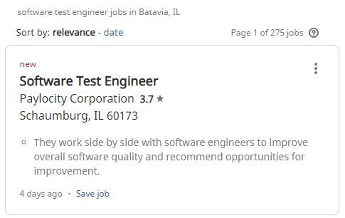
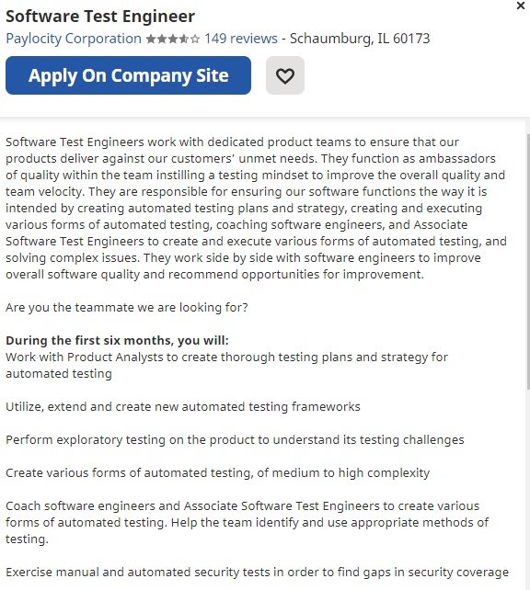
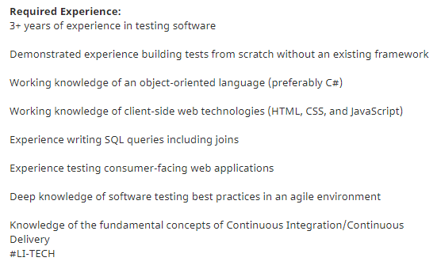
A Real Area for Jobs

Slide 3
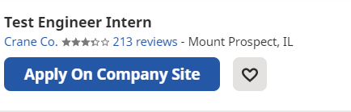
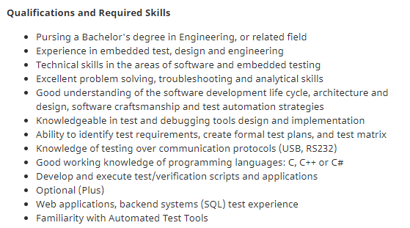
Sometimes missed for internships

Slide 4
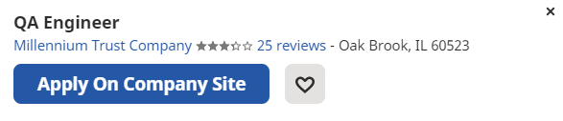
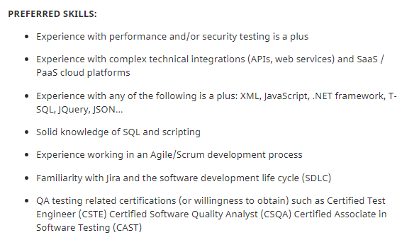
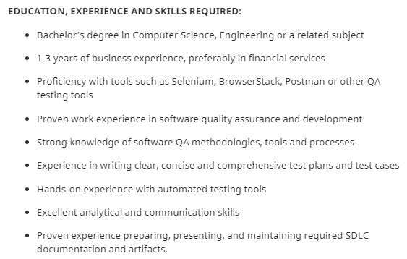
May be called QA Engineer

Slide 5
Do this now … search: “Testing
Part 0 – In google, enter the following “Software Testing Jobs Chicago”. Find 1 job.
In your own words … what are they looking for?
List the specific technologies/skills that are needed.
Report back to the group …

Slide 6
What’s wrong with these statements?
“testing is the process of demonstrating that errors are not present’’
"Testing is the process of establishing confidence that a program does what it is supposed to do.
“The purpose of testing is to show that a program performs its intended functions correctly."

Slide 7
How about this one?
Testing is the process of executing a program with the intent of finding errors.
Is it up-side-down? Since
Success is finding errors
Not success test if the test do NOT find errors
Doesn't it imply that testing is a destructive process?
Suppose someone said
"My Program is perfect" …how can you prove that?
The best way to establish confidence is to
... attempt to refute it.

Slide 8
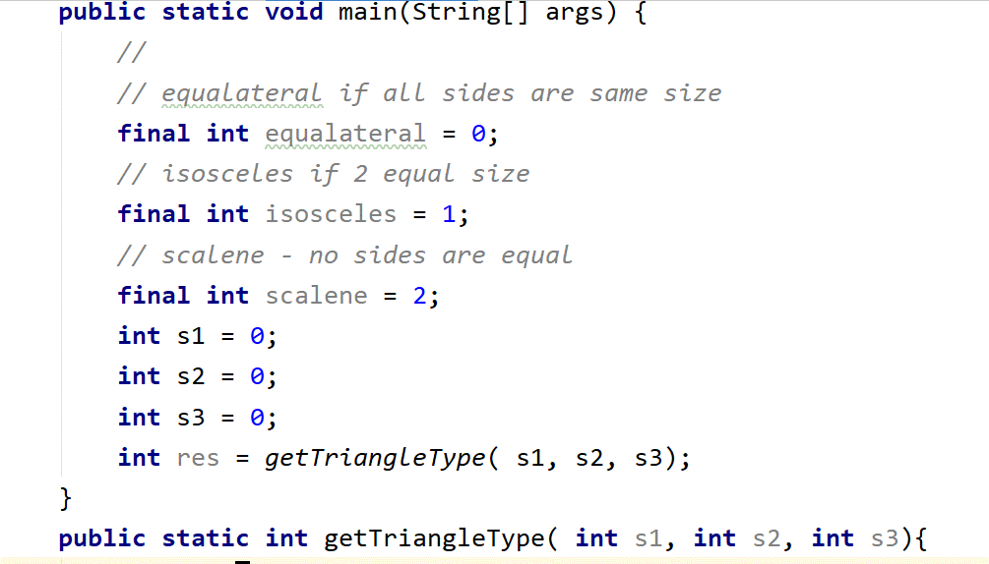
Quick Exercise ….
Do part I from Worksheet now
What test cases recommend?
Suppose this method is suppose to return a 0, 1 or 2
How would you test this problem to ensure it is correct?
List out your test cases.

Slide 9
1. valid scalene triangle?
- 3 test cases
2. valid equilateral triangle?
- 3 test cases
3. valid isosceles triangle?
- 3 test cases ..... three permutations of two equal sides (such as, 3, 3, 4; 3, 4, 3; and 4, 3, 3)?
5. Do you have a test case in which one side has a zero value?
- 0 in the test case or all are 0
6. Do you have a test case in which one side has a negative value?
- 3 cases with negative in the input
7. Do you have a test case with three integers greater than zero such that the sum of two of the numbers is equal to the third? (
That is, if the program said that 1, 2, 3 represents a scalene triangle, it would contain a bug.)
8. Do you have at least three test cases in category 7 such that you have tried all three permutations where the length of one side is equal to the sum of the lengths of the other two sides (e.g., 1, 2, 3; 1, 3, 2; and 3, 1, 2)?
9. Do you have a test case with three integers greater than zero such that the sum of two of the numbers is less than the third (such as 1, 2, 4 or 12, 15, 30)?
10. Do you have at least three test cases in category 9 such that you have tried all three permutations (e.g., 1, 2, 4; 1, 4, 2; and 4, 1, 2)?
11. Do you have a test case in which all sides are zero (0, 0, 0)?
12. Do you have at least one test case specifying noninteger values (such as 2.5, 3.5, 5.5)?
13. Do you have at least one test case specifying the wrong number of values (two rather than three integers, for example)?
14. For each test case did you specify the expected output from the program in addition to the input values?

Slide 10
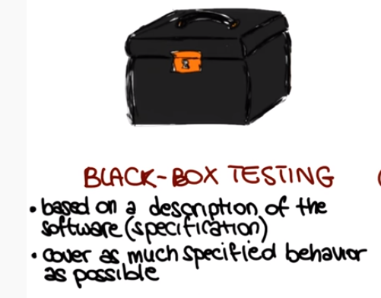
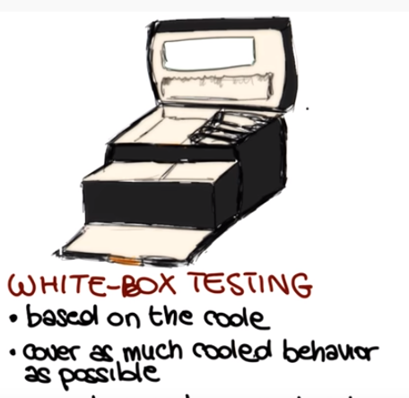
Since exhaustive testing not possible – 2 common testing strategies
Black-box testing –
White-box

Slide 11


https://www.guru99.com/black-box-testing.html
tested w/o looking at the internal code structure,
based entirely on software requirements and specifications.
Generic Black Box Testing steps:
- Examine system requirements.
- Tester chooses valid inputs and expected outputs
- constructs test cases with the selected inputs.
- Execute Test Cases and compares actual VS expected results
- Defects if any are fixed and re-tested.

Slide 12
Why black box testing isn’t enough
Module Specification:
Specification: input an integer and print it.
Here developer tries to convert input
to KB and prints
but has a typo (124 VS 1024)
def print_num_bytes( n ):
if ( n < 1024 ):
print(f"{n}")
else:
print(f"{n/124}KB")
Based on specification there is no reason to try numbers around the 1024 or 124 input
White box testing would test these conditions right away

Slide 13
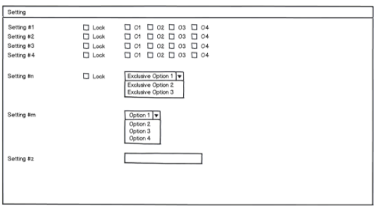
Exhaustive Black box testing => difficult
Do part II from Worksheet now
How many combinations

Slide 14
Exhaustive Black box testing => difficult
Other examples:
C++ compiler -> can you test
- all valid C++ programs (infinite number),
- all invalid C++ programs? (infinite)
Database apps -> E.g., airline reservation system,
- reserve a flight -> dependent upon previous transaction (like valid payment)
Hence, not only would you have to try all unique valid and invalid transactions, but also all possible sequences of transactions

Slide 15
Lesson -> Exhaustive input test -> impossible
Usually too many options to economically test them
objective -> get best test cases -> most likely to detect errors.
Most make some test assumptions
(e.g., if the triangle program detects 2, 2, 2 as an equilateral triangle,
it seems reasonable that it will do the same for 3, 3, 3).

Slide 16
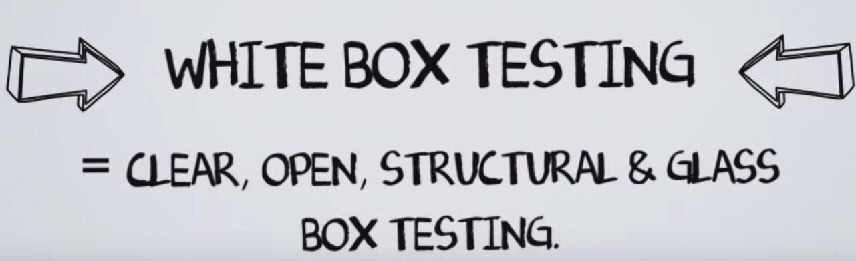
the code is visible to the tester
White Box Testing =< testing of a software solution's internal structure, design, and coding.
Focus : 1. verifying the flow of inputs and outputs through the application,
2. improving design and usability,
3. strengthening security.

Slide 17
White Box Testing Limitation example
Module Specification:
Specification: input an integer and return ½ of its value
Developer takes int of n and therefore does not work for odd numbers correctly
def get_half( n ):
res = int(n/2)
return res
Problem 1 - All power no strategy
White box testing doesn’t look at spec …
*any* input can exercise the code
Blackbox would specifically select even and odd numbers

Slide 18
White Box Testing Statement Coverage example
Module Specification: Don’t look at it
Do part III from Worksheet now
Develop a set of test cases for 100 code coverage
a=10 a=-1
B = 5 b= -2 100% coverage -> does not mean a=0 b=0
def print_sum( a, b ):
result = a + b
if result > 0:
print( f“Red:{result}”)
else if ( result < 0 ):
print(f“Blue:{result}“)

Slide 19
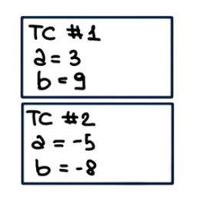
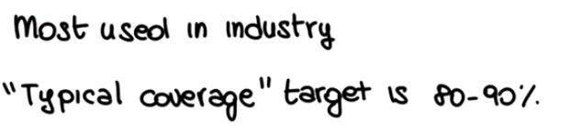
White Box Testing Statement Coverage example
2 test cases
TC1 covers lines 1,2,3,4 that is 4/6
TC2: covers line 1,2,3,4,5,6
Module Specification: Don’t look at it
def print_sum( a, b ):
result = a + b
if result > 0:
print( f“Red:{result}”)
else if ( result < 0 ):
print(f“Blue:{result}“)
But … did you note the bug? … what happens a 0?

Slide 20

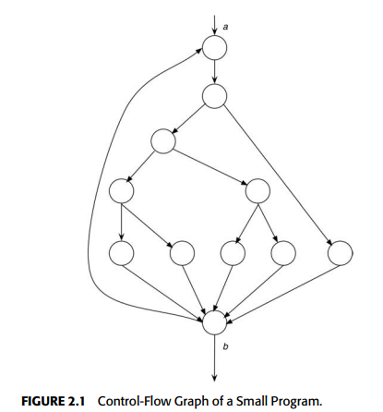
-> A 10- to 20-statement program consisting of a DO loop
that iterates up to 20 times.
- W/I Loop -> a set of nested IF statements.
- Aprox 10**14 execution paths
Problem 2 – too many paths

Slide 21
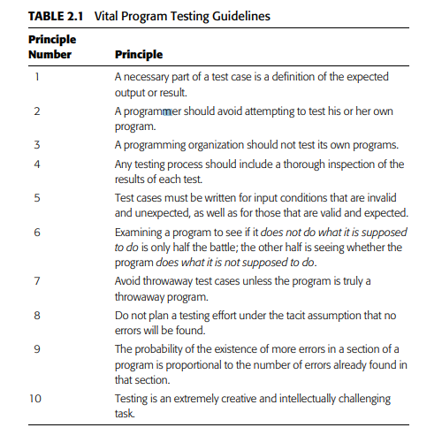
Software Testing Principles
You and your entire organization … should not test your own code

Slide 22
Principle 1: A necessary part of a test case is a definition of the expected output or result.
W/o predefined expected result -> might interpret a plausible, but erroneous result as correct
A test case must have
1. input data description
2. Correct output precise description (for that input)

Slide 23
Principle 2: A programmer should avoid attempting to test his or her own program
Principle 3: A programming organization should not test its own programs
Devs have a pre-defined perspective … a constructive eye…
Good testers have more of a destructive eye
A developer naturally has
1. a constructive perspective
2. a specific interpretation of the spec
Not impossible to test your own … but certainly more difficult
Dev organizations tend to have the same constructive perspective

Slide 24
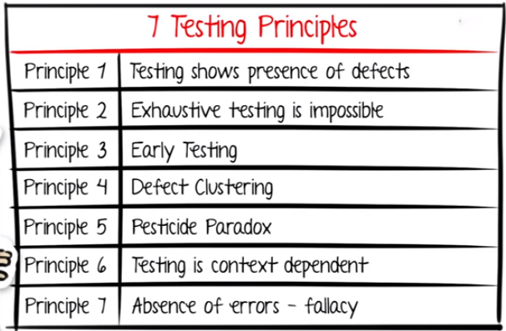
7 Principles of Software Testing: Defect Clustering and Pareto Principle (softwaretestinghelp.com)
7 testing Principles (see video https://youtu.be/rFaWOw8bIMM ) 5:01

Slide 25
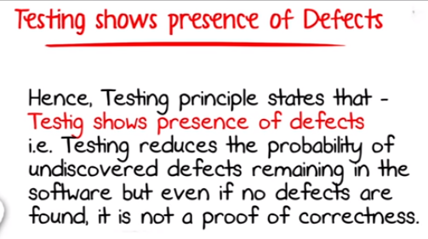
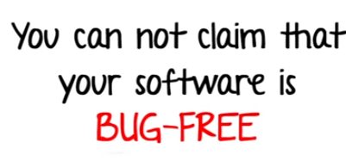
1. Testing show presence of defects
Testing pros will NOT say … that there is no defect in the software
Testing is NOT a proof of correctness
Principle 1
E.g., Often times customers try totally unpredictable functions/option combinations

Slide 26
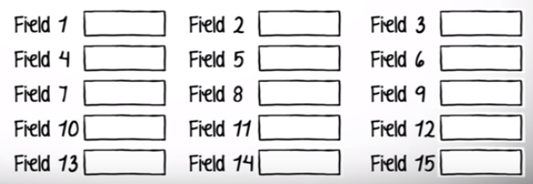
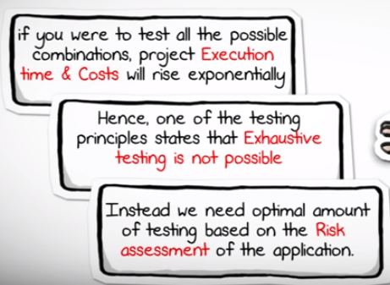
2. Exhaustive testing in not practical => Need optimal testing based on the app’s risk assessment
E.g. Input fields that accepts a-z, and #s from 1-1000 only Imagine # of input combos
Test strategy comes from understanding the app
Question …. What operation is most likely to cause windows O/S to fail?
How do you determine this risk?

Slide 27
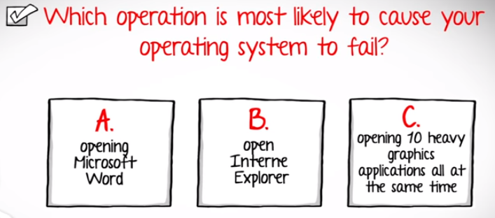
For example … which one do you test first?
Question 2: After your exhaustive testing and retesting … is your program bug-free?

Slide 28
Principle 2 – Exhaustive Testing is not possible

Slide 29
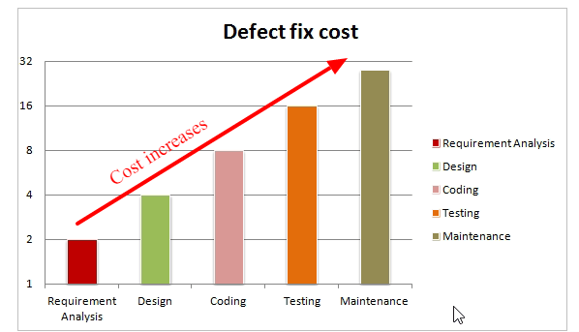
Principle 3 Early Testing as soon a possible
Want to detect defects as soon as possible …
once in the field … can be super expensive

Slide 30
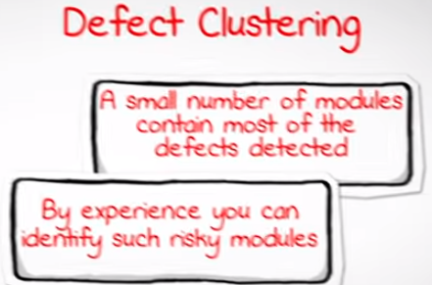
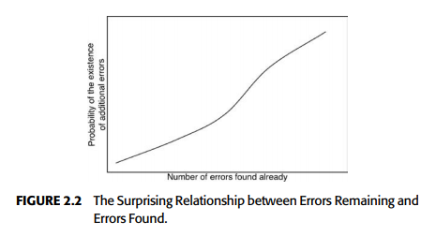
Principle 4 – Defect Clustering
The probability of the existence of more errors in a section of a program is proportional to the number of errors already found in that section
some sections seem to be much more prone to errors than other section

Slide 31
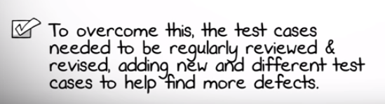

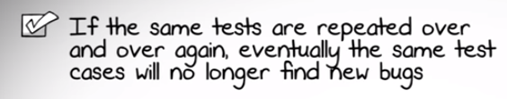
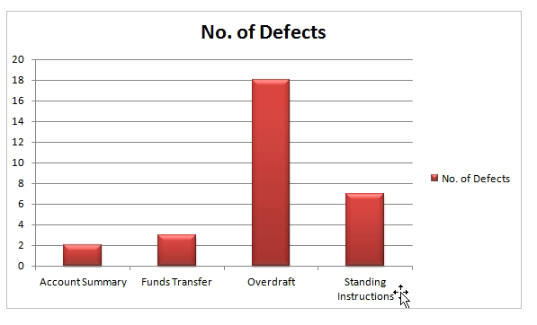
Principle 5 – Pesticide Paradox
E.g., if find overdraft errors … tend to add more and more overdraft test cases
Over time … will be fixed … need to look into new test cases to find other bugs

Slide 32

Principle 6 – Test is Context Dependent –
Different strategies for different products
E.g, Testing
banking application VS any e-commerce app.
Risk much different
techniques must be different.

Slide 33

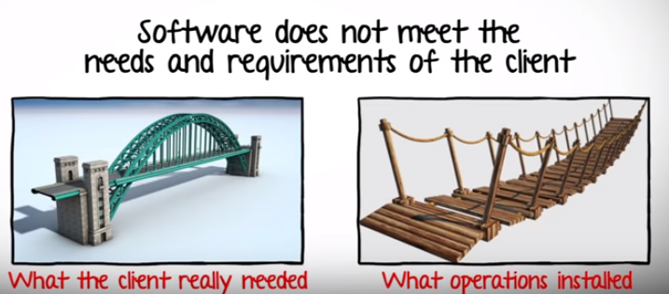
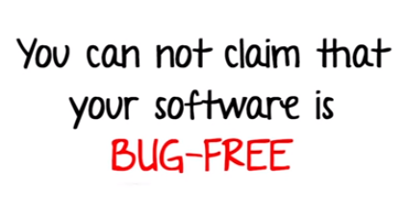
Principle 7 – Absence of errors => Fallacy
E.g., a requirement could be interpreted incorrectly

Slide 34
7 testing Principles (see video https://youtu.be/rFaWOw8bIMM ) 5:01

Slide 35
A few summary statements
Testing is the process of executing a program with the intent of finding errors.
Testing is more successful when not performed by the developer(s).
A good test case is one that has a high probability of detecting an undiscovered error.
A successful test case is one that detects an undiscovered error.
Successful testing includes carefully defining expected output as well as input. Successful testing includes carefully studying test results

